Slide 1

Pressure Effects of Dimple-Like Ridges
Nicholas Batista
MAE 6226
5/7/2015

Slide 2
Method of Analysis
XFLR5-->Visualize Effects of Dimpled Ridge
Source Panel Method-->Pressure Calculation & Visualization
Design Considerations-->Induced Stagnation points-->Downward force on dimple surface

Slide 3
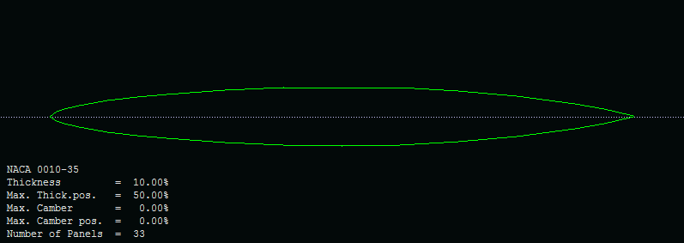
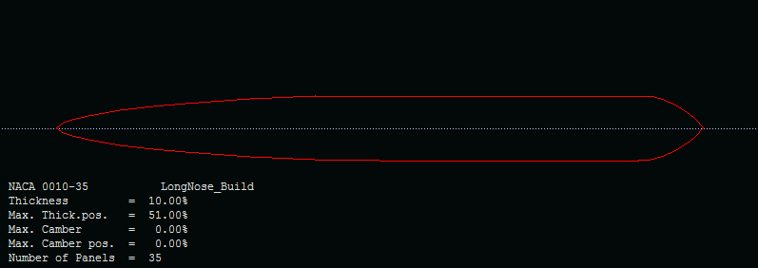

Slide 4
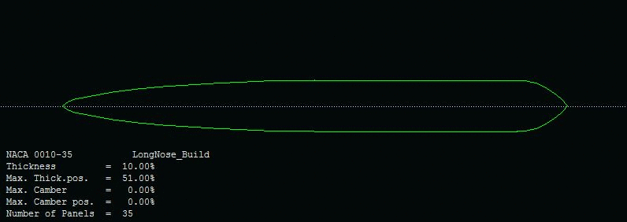
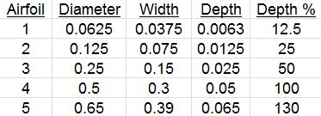

Slide 5
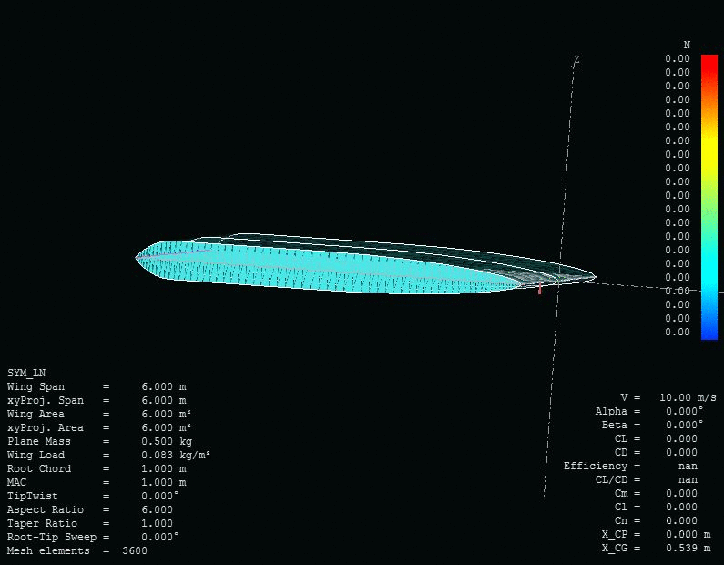
XFLR5 Vortex Lattice Method Analysis

Slide 6
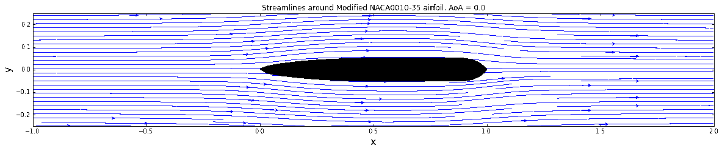
Source Panel Method
Python code

Slide 7
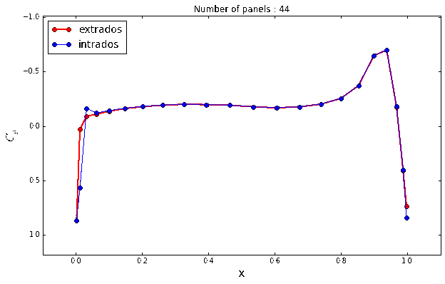

Slide 8
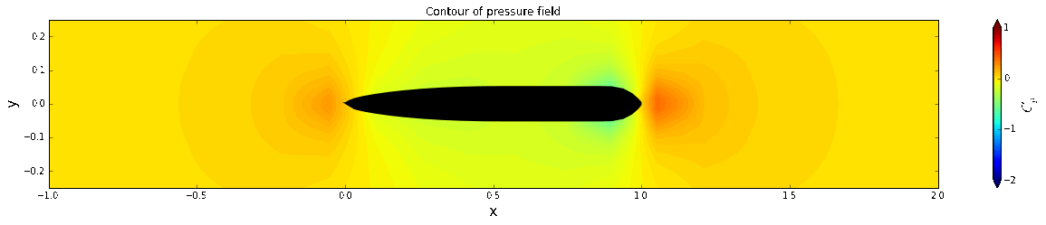
Discussion

